Slide 1





Text Compressor
Team Introduction
Presented by :
Binary Builders
CSE - 64_E
Presented to :
Most. Hasna Hena
Assistant Professor
Department of CSE
Daffodil International University
Nahid Mahbub
ID - 1632
Nayeem Hasan
ID - 1003
SUVOSING PARTHO
ID - 1445
Awal Hossan
ID - 1840

Slide 2
Team Introduction
Nahid Mahbub
Nayeem Hasan
SHUVO SINGH PARTHO
Awal Hossan

Slide 3









TEXT COMPRESSOR

Slide 4

INTRODUCTION

Slide 5


INTRODUCTION
A text compressor is a tool designed to reduce the size of text files, making them more manageable for storage or transmission. The process involves using various algorithms to encode the data in a more efficient way, eliminating redundant or unnecessary information without compromising the essential content.

Slide 6

DS USED

Slide 7
DS USED
• Tree
• Heap
• HashMap

Slide 8

Function & Features

Slide 9
Function & Features
Step 1: We have to count the frequency of each character of that string.
Step 2: We have to creat a min heap.From min heap we will choose two characters with the minimum counts and sum it up. We will repeat the steps till we form a complete tree.
Step 3: Since now it is no longer sorted first we will sort it again . After sorting we will again pick the minimum count and sum it up.
Step 4: Then we will assign 0 to the left edges and 1 to the right edges. To assing the codes to each character we will travers the tree from the root node to the leaf node of each character.

Slide 10
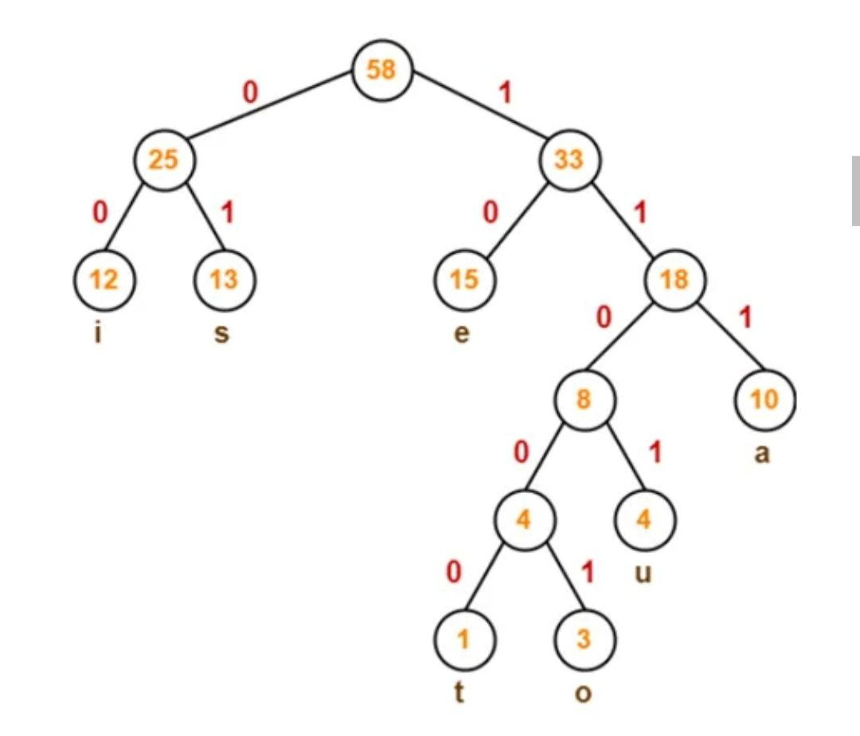
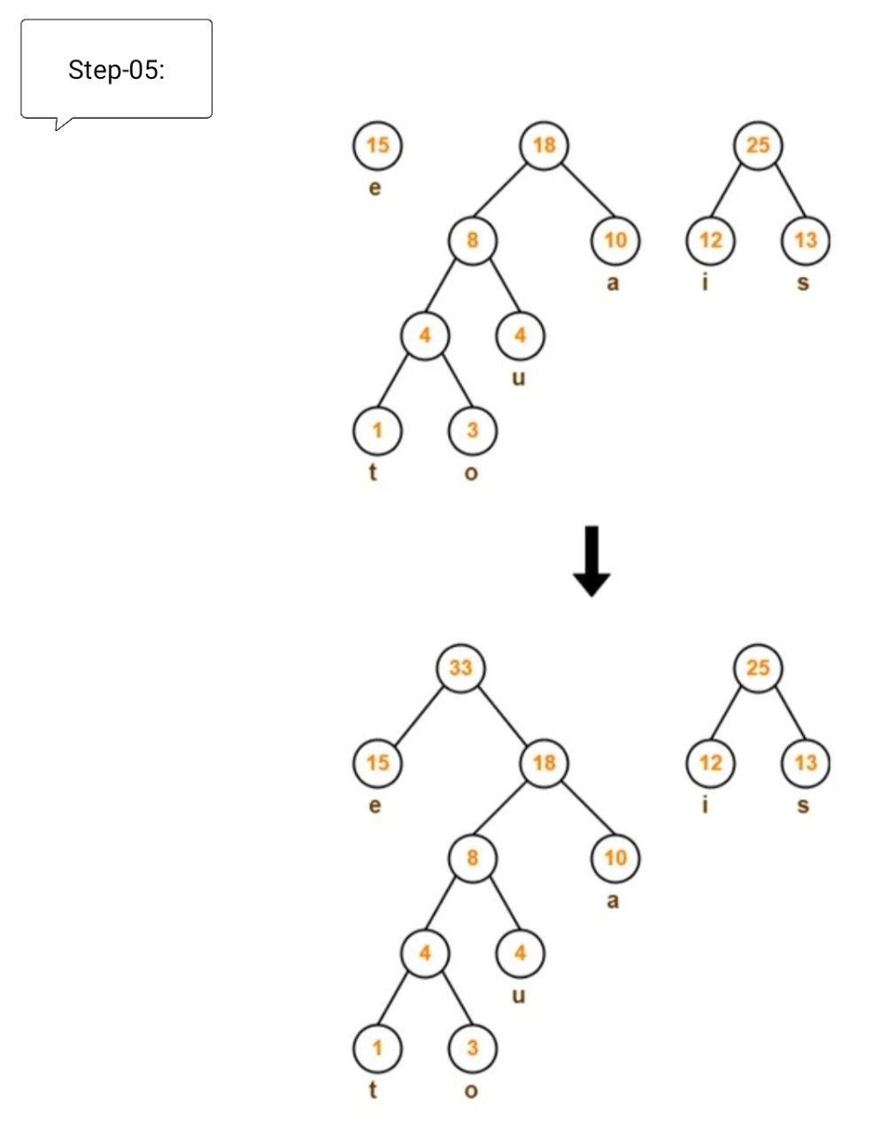
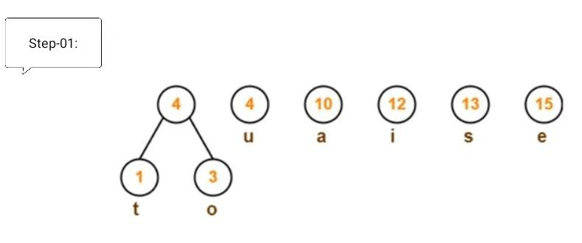
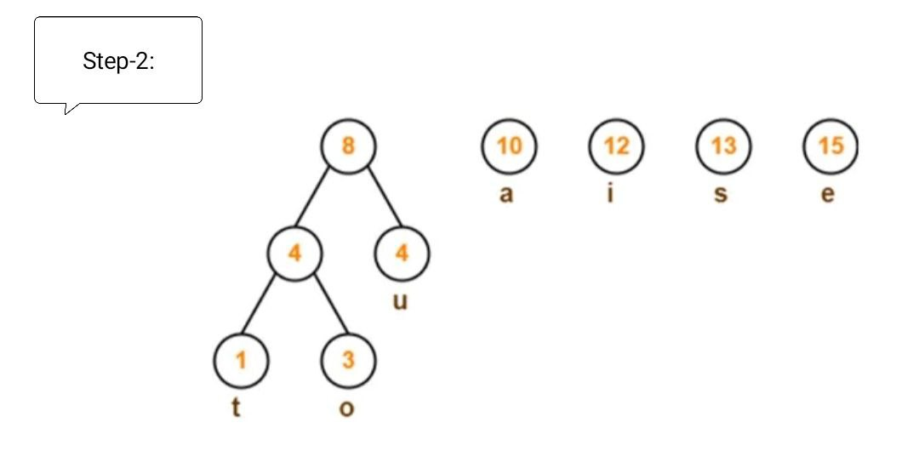
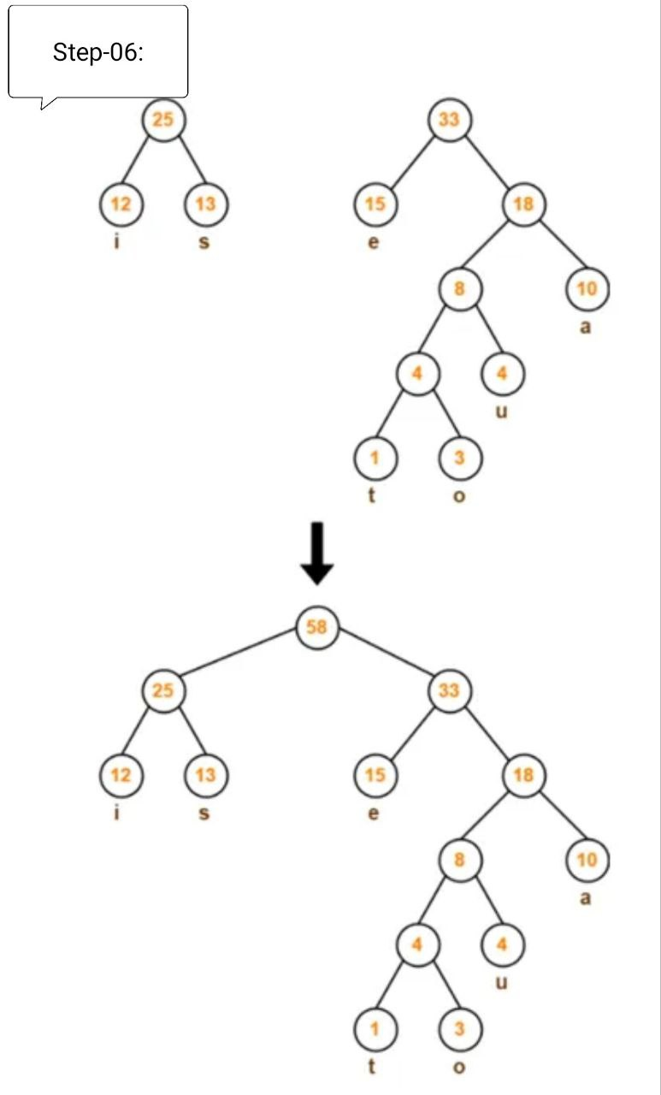
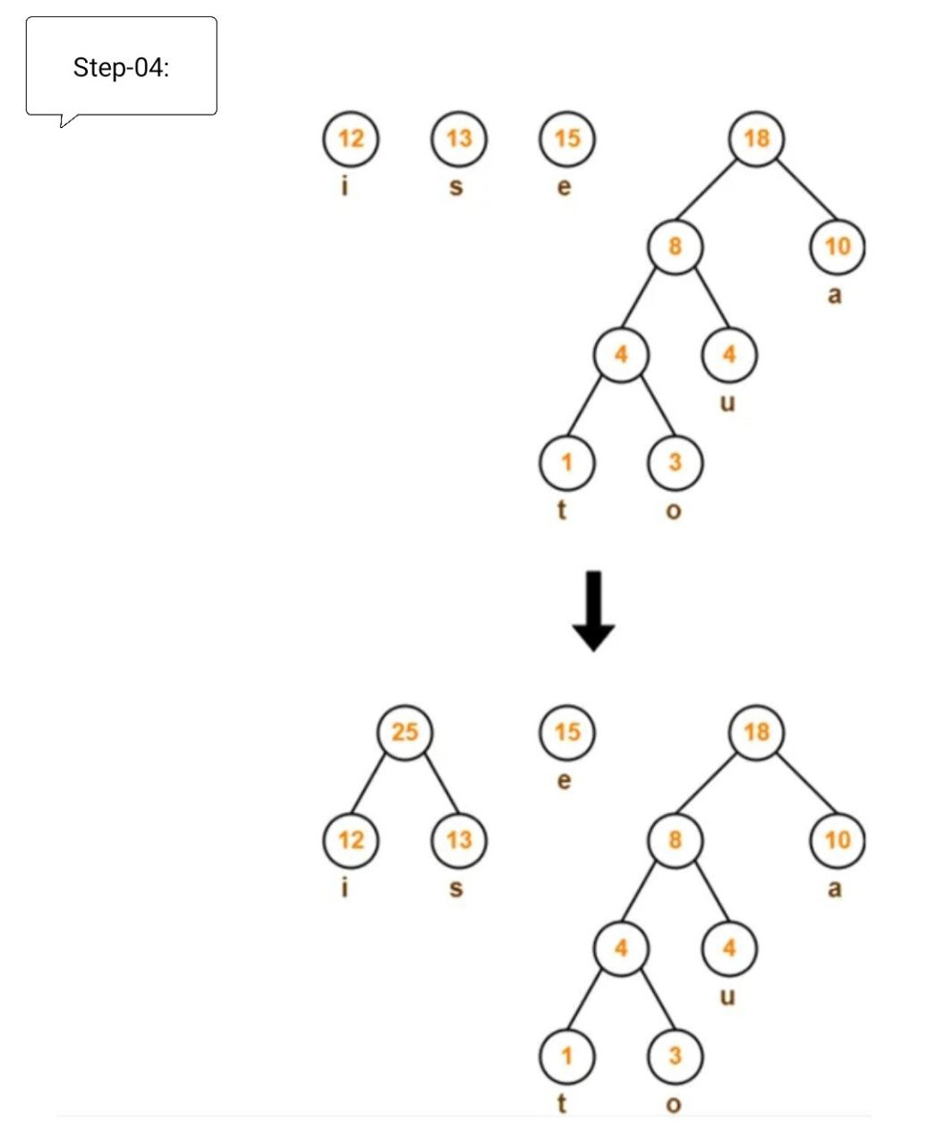
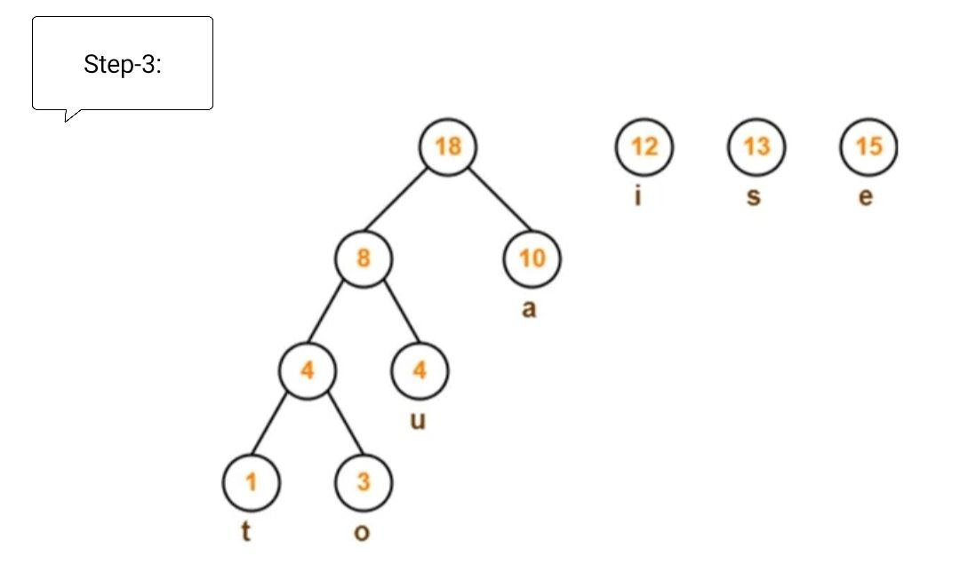

Slide 13

Conclusion

Slide 14
Conclusion
In conclusion, the Huffman compression project has delivered a successful implementation of the Huffman coding algorithm. The project effectively demonstrated the principles of variable-length encoding, frequency-based symbol representation, and the construction of an optimal binary tree for lossless data compression. Through a clear and modular code structure, the implementation achieved efficient compression and decompression processes. The project's success underscores the importance and versatility of Huffman coding in reducing data size while preserving content integrity. This project provides a solid foundation for understanding and applying Huffman coding in practical scenarios, offering valuable insights into compression algorithms and their significance in various domains.

Slide 15
Conclusion
Thank You
In conclusion, the Huffman compression project has delivered a successful implementation of the Huffman coding algorithm. The project effectively demonstrated the principles of variable-length encoding, frequency-based symbol representation, and the construction of an optimal binary tree for lossless data compression. Through a clear and modular code structure, the implementation achieved efficient compression and decompression processes. The project's success underscores the importance and versatility of Huffman coding in reducing data size while preserving content integrity. This project provides a solid foundation for understanding and applying Huffman coding in practical scenarios, offering valuable insights into compression algorithms and their significance in various domains.

